Slide 1
WebWork in Action
An introduction to WebWork
Patrick A. Lightbody

Slide 2
Introduction
WebWork: an OpenSymphony project
  What is WebWork?
  What is OpenSymphony?
Who is Patrick?
Comparison to other web frameworks
  Struts
  Tapestry
  JSF

Slide 3
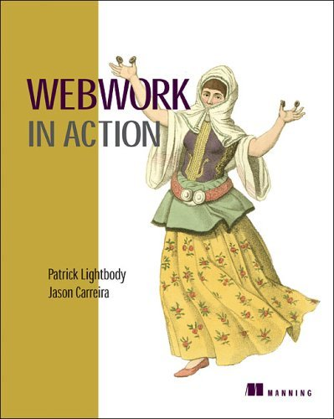
eBook now available
Print version ready “any day now”
Ask questions - get a free copy!

Slide 4
“Wow” example
Getting started has never been easier
Demonstration of:
  Inversion of Control
  Template library
  Type conversion
  Validation

Slide 5
Demo…

Slide 6
Overview: WebWork…
Is built upon the Command Pattern
Works with POJOs
Uses OGNL for expression language and type conversion
Has an advanced validation framework
Includes an extensible widget system
Supports many view technologies: JSP, FreeMarker, Velocity, JasperReports, XSLT, etc

Slide 7
Core concepts
Three key pieces:
  Actions (POJOs, ActionSupport)
  Results
  Interceptors
No “form beans”: the action is the model
Value stack allows loose coupling
Interceptors: “AOP lite”

Slide 8
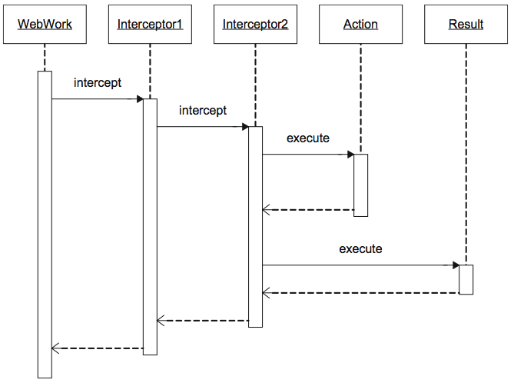

Slide 9
Getting started
Two options:
  Standard servlet (2.3) container
  New “prototype” quick start
Both methods are compatible
  develop in “prototype” and deploy in a standard servlet container

Slide 10
Servlet container
Everything starts with the FilterDispatcher
The FilterDispatcher is responsible for:
  Executing actions
  Serving static content (AJAX-related files)
  The inversion of control “request” scope
  Cleaning up the ActionContext (ThreadLocal)

Slide 11
web.xml
<filter>
<filter-name>webwork</filter-name>
<filter-class>….FilterDispatcher</filter-class>
</filter>
<filter-mapping>
<filter-name>webwork</filter-name>
<url-pattern>/*</url-pattern>
</filter-mapping>
<listener>
<listener-class>….LifecycleListener</listener-class>
</listener>

Slide 12
“Prototype”
Is the quickest way to get started
Is inspired by AppFuse, Ruby on Rails
Is powered by a built-in Jetty server
Automatically compiles your source files
Gets your started in three steps:
  Unzip webwork-2.2.zip
  cp -R webapps/starter webapps/javazone
  java -jar launcher.jar prototype:javazone

Slide 13
xwork.xml
Configuration for actions, results, and interceptors
Support for packages and package inheritence
  Optional mapping to namespaces
Additional files can be included using <include>

Slide 14
xwork.xml Example
<xwork>
<include file="webwork-default.xml"/>
<package name="default”
extends="webwork-default">
<action name="listPeople" class="ListPeople">
<result>listPeople.ftl</result>
</action>
</package>
</xwork>

Slide 15
Value stack
All expressions work against the value stack
Actions are pushed on the stack before anything else happens
Additional objects, such as those in an interator or action chaining, can be pushed down

Slide 16
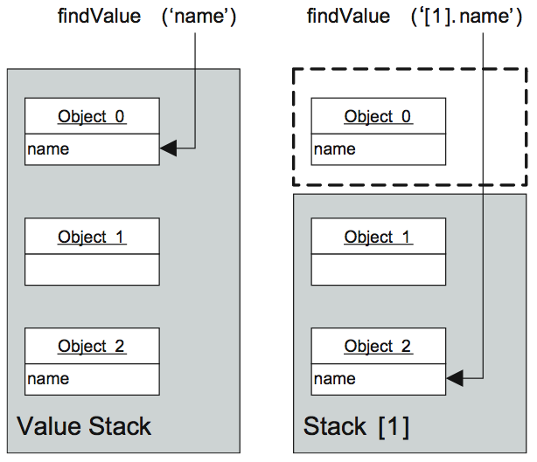

Slide 17
Type conversion
HTTP is not aware of data types…
  … but Java is!
  WebWork helps by letting you work with your raw POJOs rather than typeless intermediate objects (form beans).
Helps with simple conversion (primitives) as well as complex (POJOs and collections)

Slide 18
Type conversion examples
String -> int
  <input name=“id”/>
String[] -> List<String>
  <input name=“name”/>
Complex types
  <input name=“person.id”/>
  <input name=“people[0].id”/>
  <input name=“person.friends.name”/>

Slide 19
Validation
Abstracts validation rules from core code
Common rules available (required, regex, date range, etc)
Sames rules work with client-side validation (using AJAX -- see my other presentation for more info)

Slide 20
Template library
Platform to create reusable UI widgets
Form controls provided out of the box
Groups of templates form “themes”
The “xhtml” theme is simple two-column layout
Themes can extend each other
  ajax -> xhtml -> simple

Slide 21
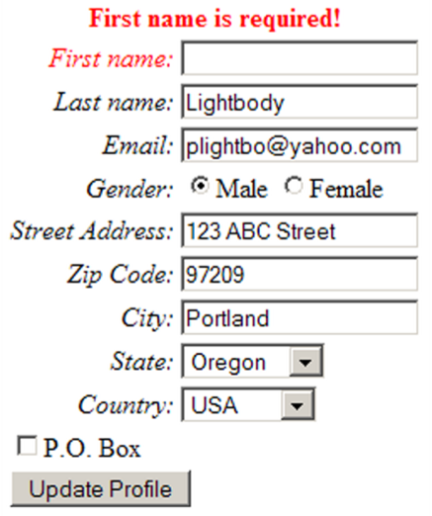
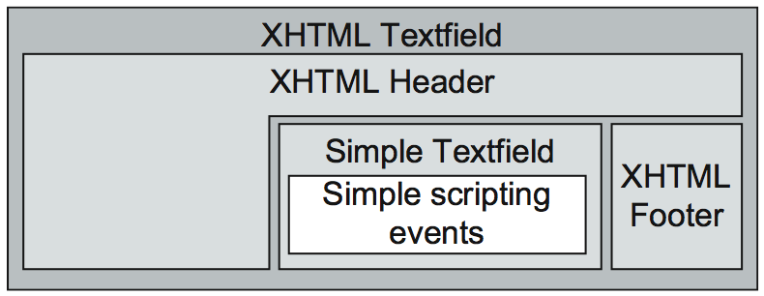
The xhtml theme extends the simple theme and provides a standard two-column layout…

Slide 22
Uses of interceptors
Provide very core features for WebWork:
  Logging
  Applying HTTP request parameters
  Invoking IoC
  Invoking the validation framework
Also provide advanced functionality…

Slide 23
Advanced features
Action chaining
  Lets you glue together smaller actions to form more complex workflows
  CreateUser -> Login
Automatic “wait” pages
  Great for complex search operations
Prevent double click problems (without relying on JavaScript!)

Slide 24
Demo…

Slide 25
Wrapping up
Prototype is a great way to get started
Utilize the templates; create your own themes
Type conversion bridges the gap between HTTP and Java
Use the validation framework (especially with AJAX)
Utilize interceptors when appropriate

Slide 26
Questions?

